Slide 1
Esophageal motility disorders
EDNA KAMAU

Slide 2

Objectives
Diagnosis and classification of esophageal motility disorders (Chicago classification 4.0)
Recognize the role of high-resolution manometry in diagnosis
Highlight management principles
Neurogastroenterol Motility 2021 Jan;33(1).
Esophageal motility disorders on high-resolution manometry: Chicago classification version 4.0© Rena Yadlapati

Slide 3
Clinical presentation
Esophagus dysphagia-
Food getting stuck at the neck or chest
Dysphagia to liquids and solids
Non-cardiac chest pain
Regurgitation
Heart burn-refractory
Notes:
Versus oropharyngeal dysphagia
Symptoms of esophagus dysmotility

Slide 4
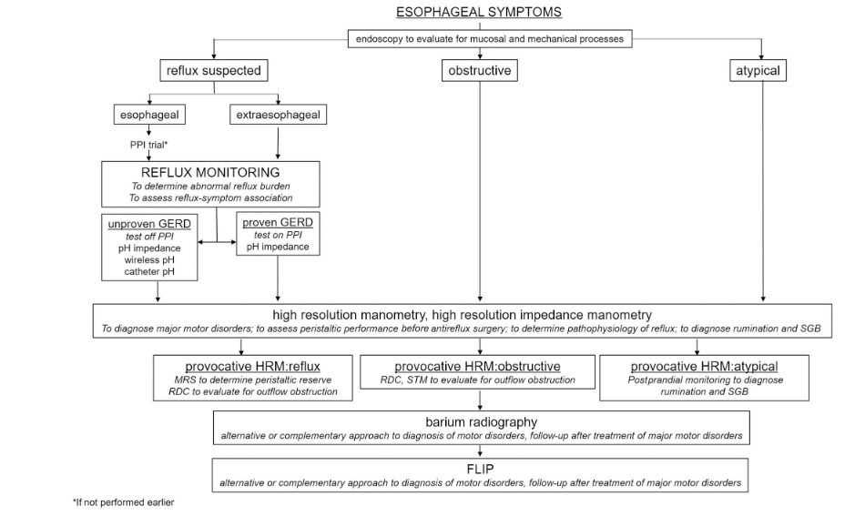

Slide 5
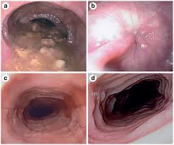
Upper GI endoscopy
No structural abnormalities
No mucosal inflammatory conditions
Findings suggestive of esophagus dysmotility

Slide 7
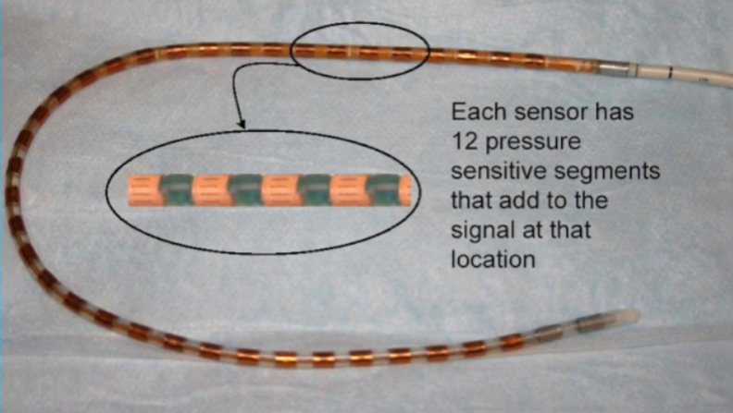
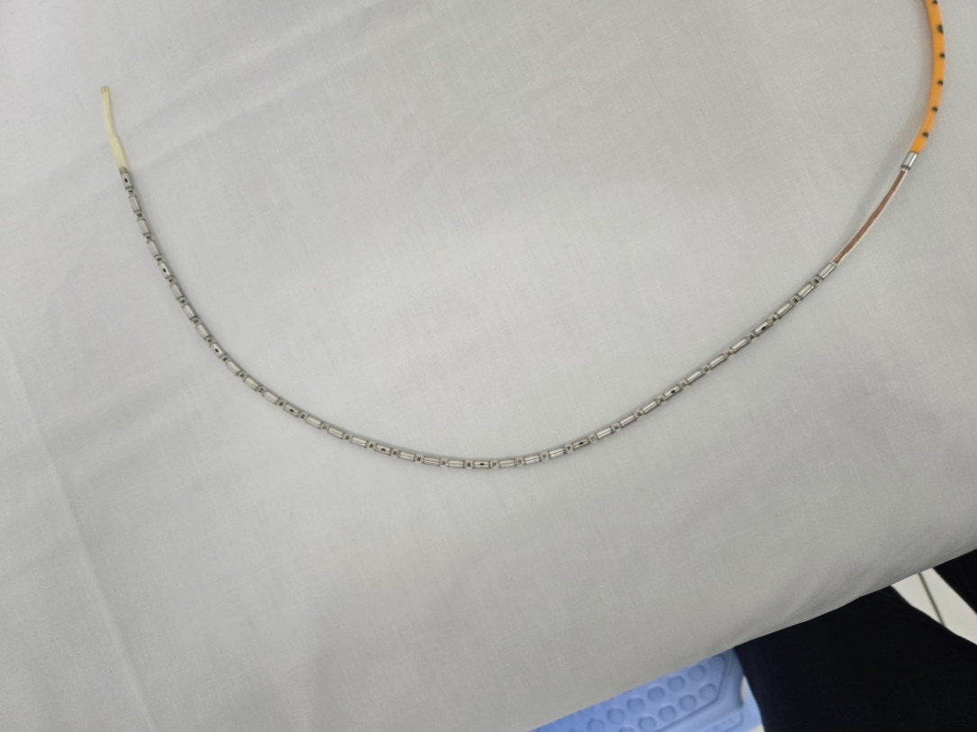
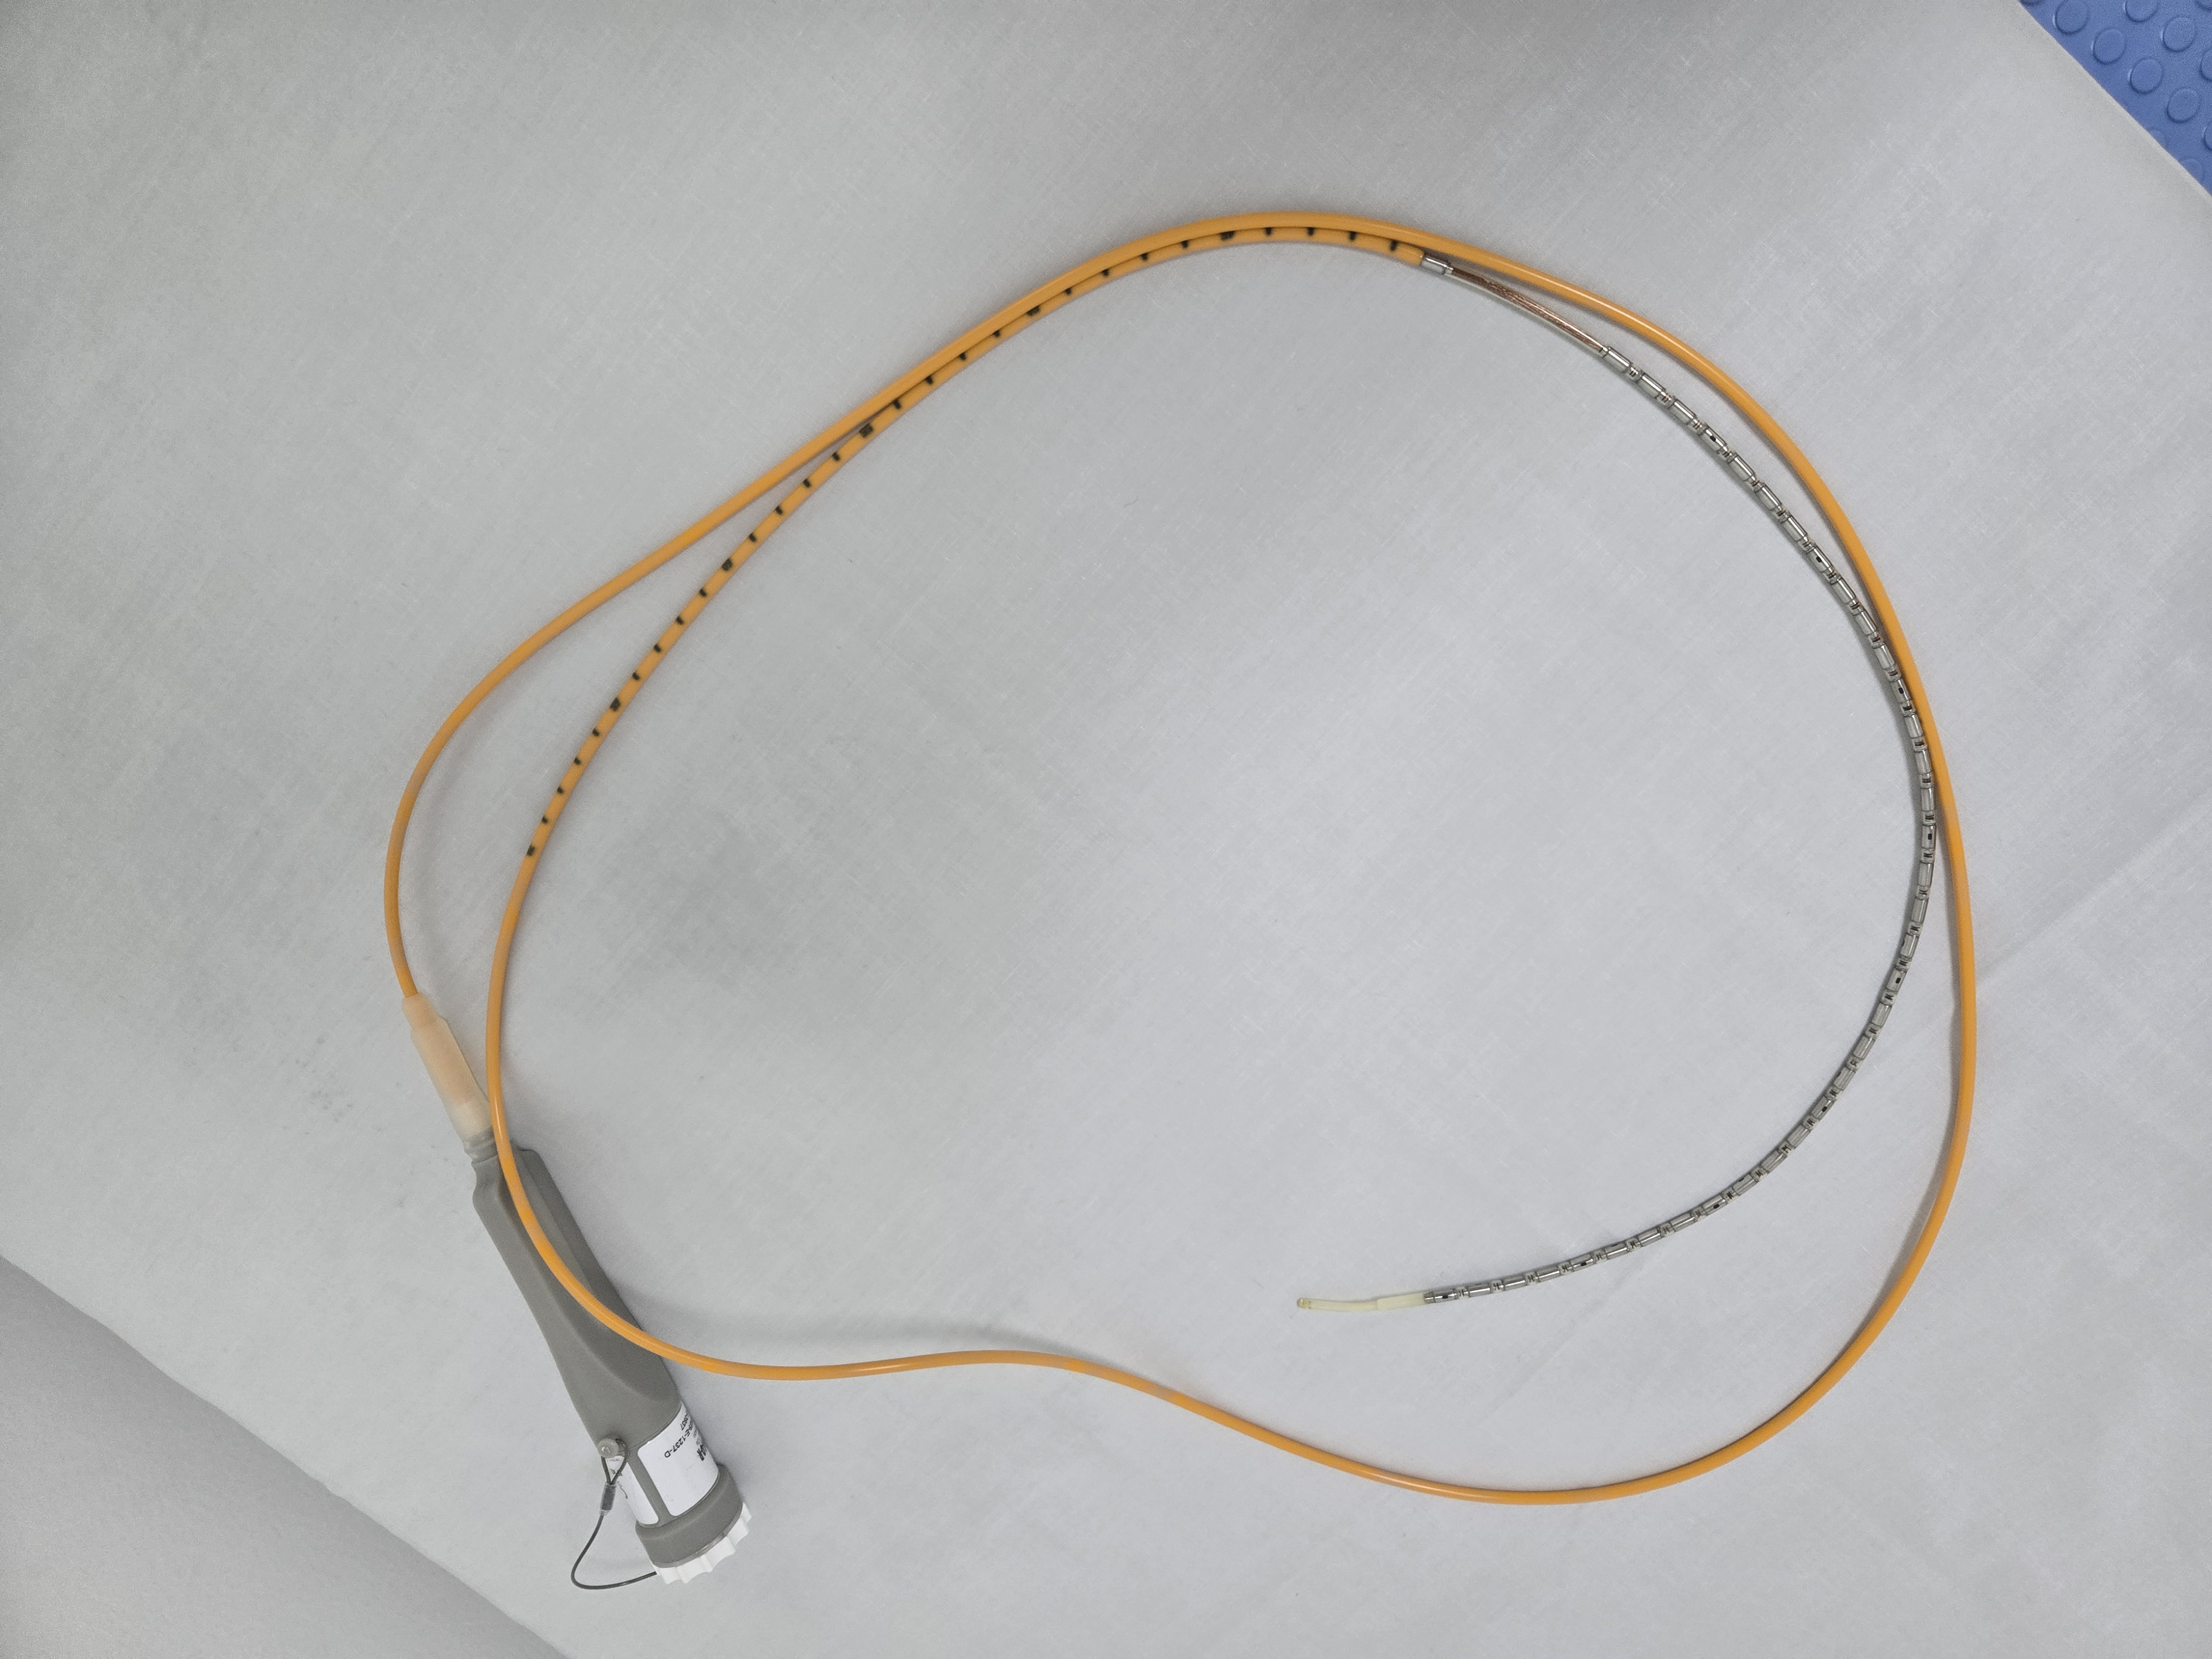
Esophagus manometry
Developed in 1970s
Gold standard of esophagus motility testing

Slide 8
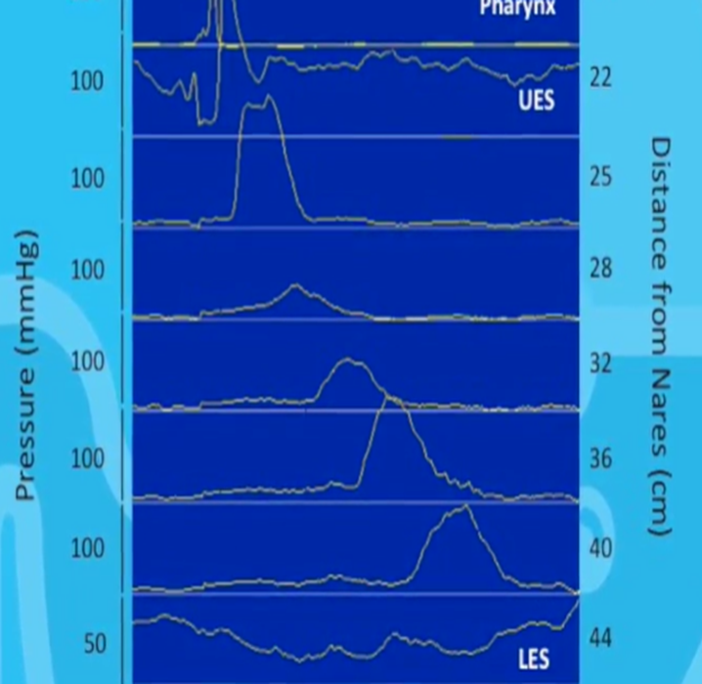
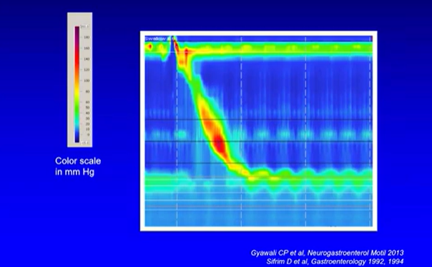
High resolution manometry
Notes:
Clouse plots, also known as esophageal pressure topography (EPT) plots, are a way of visualizing the pressure data collected during high-resolution esophageal manometry (HRM). They are color-coded, spatiotemporal representations of pressure readings along the esophagus,
The plots show how pressure changes over time and along the length of the esophagus, allowing for detailed analysis of esophageal function.

Slide 9
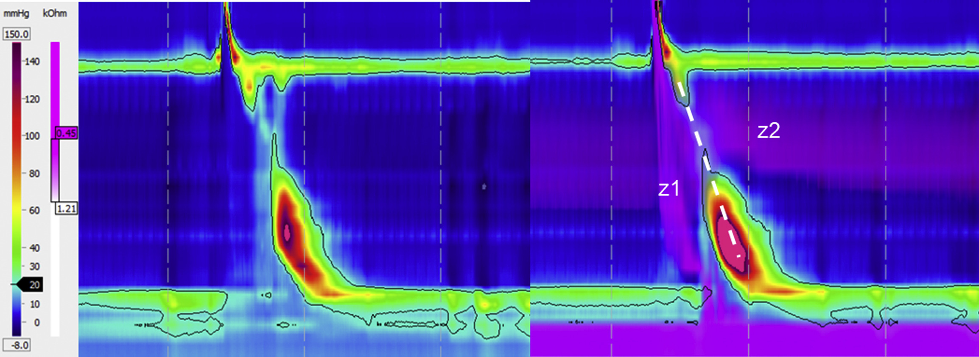
High resolution impedance manometry
Notes:
Important with rumination syndromes

Slide 10
Esophagus manometry analysis
Assessment of esophageal gastric junction (EGJ)
-Resting pressure (?high or low)
-Does the EGJ relax adequately with wet swallows
-Hiatus hernia
Esophageal body response to wet swallows
-Is peristalsis present or absent
-Peristaltic amplitude (high or low)
-Is spasm present
Notes:
TWO important ASPECTS TO ESO MANO ANALYSIS

Slide 11
ESOPHAGUS MANOMETRIC METRICS
INTERGRATED RELAXATION PRESSURE (IRP)
DISTAL CONTRACTILE INTERGRAL (DCI)
DISTAL LATENCY (DL)
Notes:
3 metrics that allow us to characterize the behavior of the esophagus

Slide 12
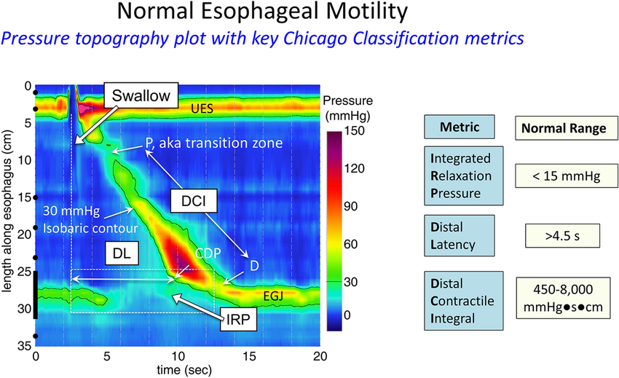

Slide 13
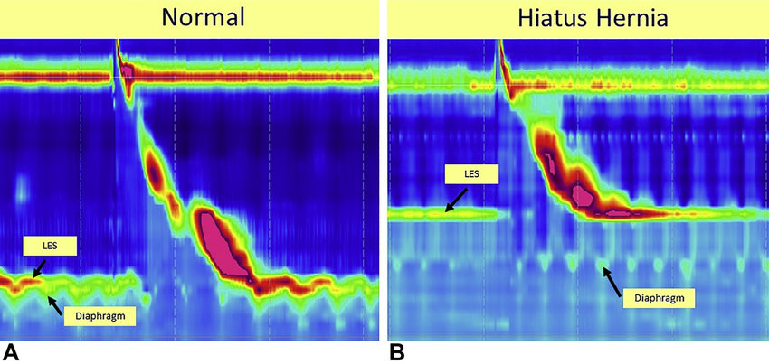

Slide 14
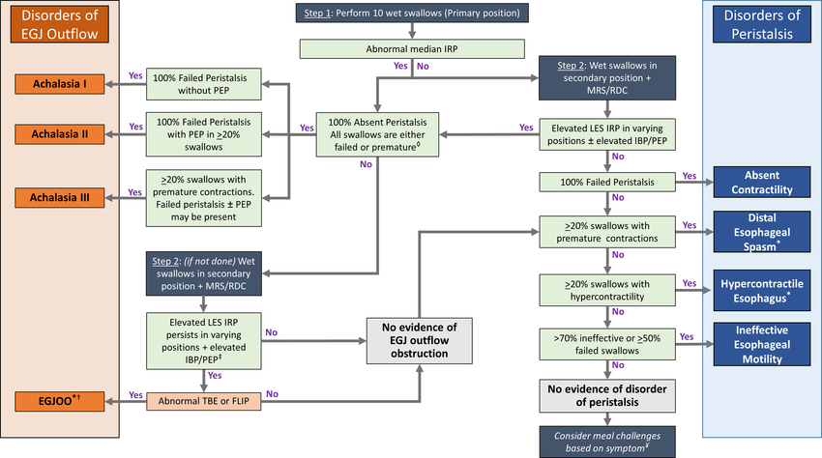
CHICAGO 4.0
Notes:
UPDATES SINCE 2009
PETER KHARALRIS NORTH WESTERN UNIVERSITY
HIERCAHLE
5 STEPS
STARTS WITH MAJOR
CLASSIFIES THE DISEASES BASED ON THE 3 METRICS

Slide 15
DISORDERS OF EGJ OUTFLOW

Slide 16
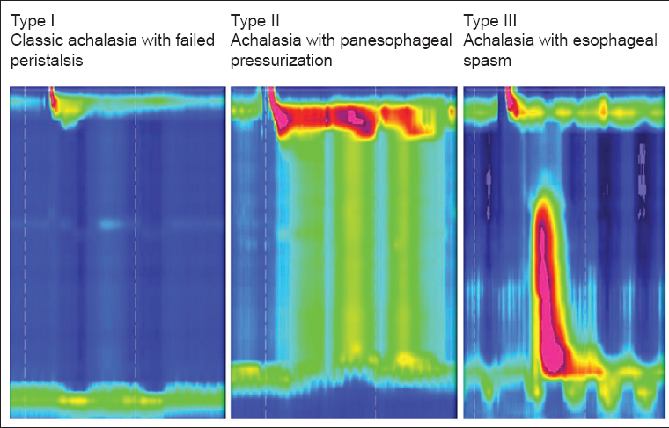
ACHALASIA
Notes:
Type I achalasia is considered the classic presentation of achalasia, and typically a later state of disease progression
Type II achalasia is considered an earlier stage of disease and carries the most favorable prognosis to treatments.54
Type III achalasia is akin to spastic achalasia, and may reflect a different pathophysiologic consequence than theother subtypes, with less evidence of progressive neuronal cell loss of the myenteric ganglion cells of the distalesophagus and LES.53,

Slide 17
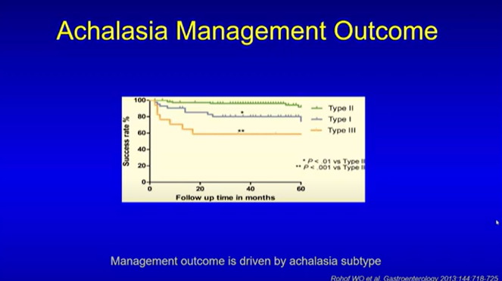

Slide 18
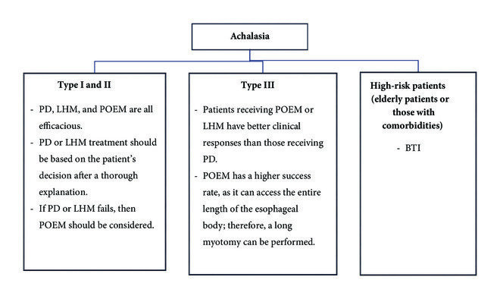

Slide 19
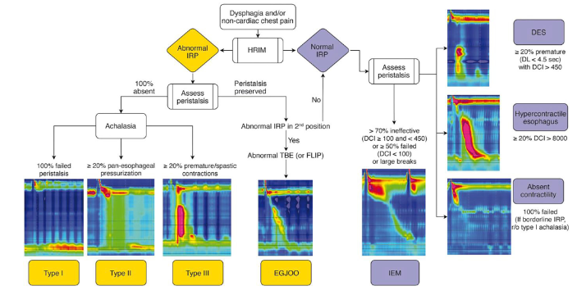

Slide 20
EGJ OUTFLOW OBSTRUCTION
Patient 1-dci 189 mmhg.s.cm
Patient 2-dci 2272mmhg.s.cm
DCI 189 mmHg.s.cm
Notes:
Post-nissen fundoplication
Strictures
Achalasia in evolution
Opiods

Slide 21
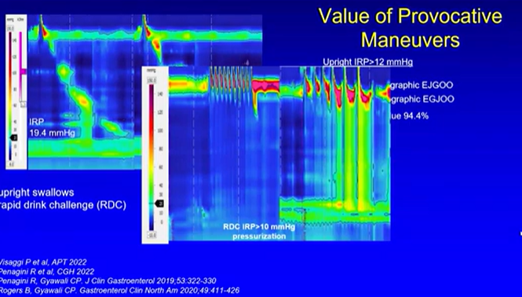
EGJ OUTLET OBSTRUCTION
Notes:
CAUSES> VERY TIGHT WRAP POST FUNDOPLICATION, OPIODS, ACHALASIA

Slide 22
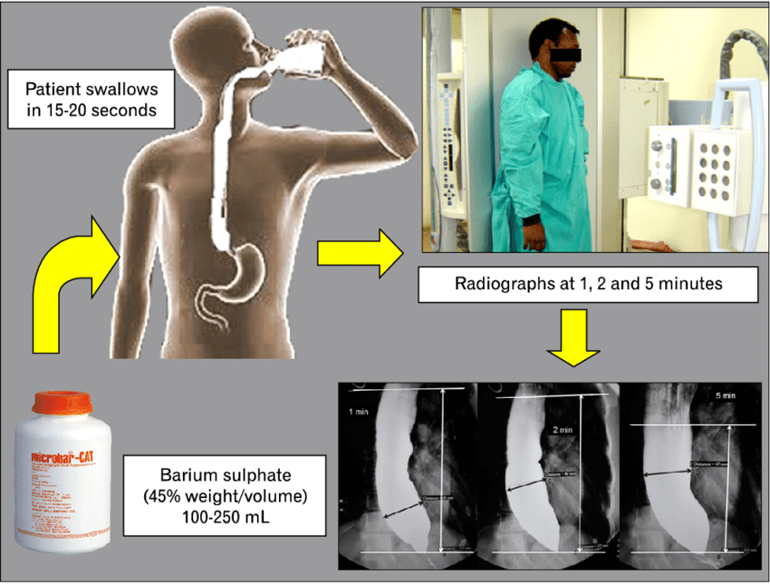
Timed barium esophagogram
Notes:
PERISTALTIC COMPRESSION, ESOPHAGUS DILATATION AND EMPTYINGWe propose that barium height >2 cm at 5 min be used as cutoff point for identifying achalasia

Slide 23
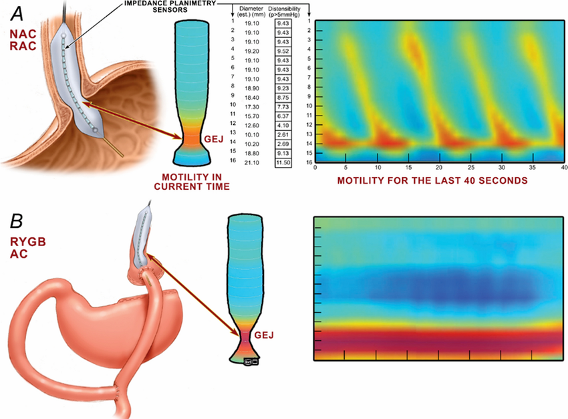
ENDO-FLIP

Slide 24
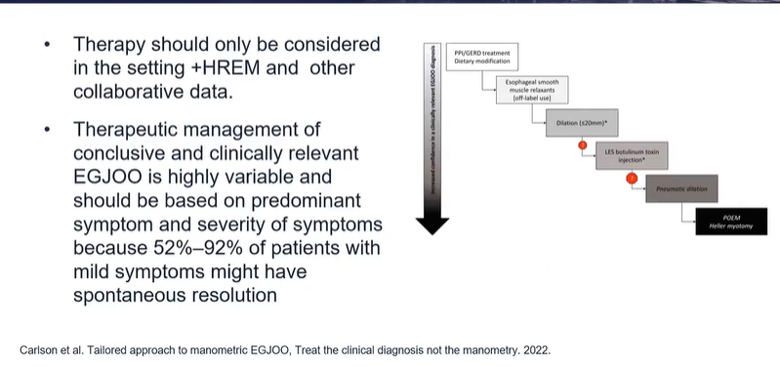
TREATMENT OF EGJOO

Slide 26
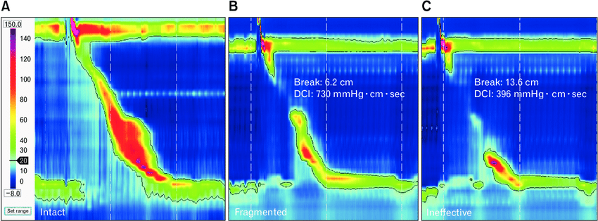
DISORDERS OF PERISTALSIS

Slide 27
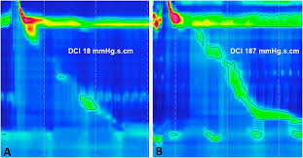
HYPOMOTILITY DISORDERS: INEFFECTIVE ESOPHAGUS MOTILITY & ABSENT CONTRACTILITY
Notes:
ABSENT CONTRACTILITY –SCLERODERMA

Slide 28
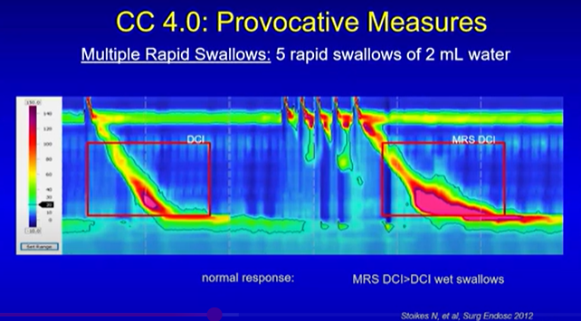
HYPOCONTRACTILE DISEASES

Slide 29
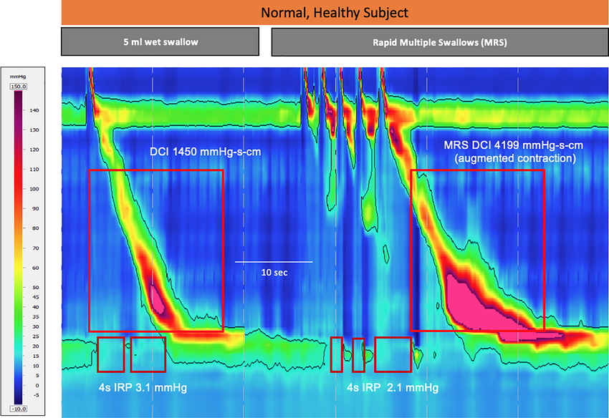
Value of HRM pre-fundoplication
Lack of augmentation post MRS indicates poor contractile reserve to physiological and iatrogenic response
Increased post fundoplication dysphagia
Notes:
Multiple Rapid Swallows (MRS) is a physiological test that increases deglutitive inhibition of the esophageal contration and EGJ by asking the subject to swallow five times in quick succession. Subsequently, in healthy subjects, the MRS post‐contraction is often augmented (more vigorous than normal). MRS highlights failure of deglutitive inhibition in patients with achalasia, esophageal spasm and hypercontractile disorders. Additionally,

Slide 30
CASE REPORT
DCI 129 mmHg.s.cm
Peristaltic breaks 6,3 cm
DCI 143 mmHg.s.cm
Peristaltic breaks 4,8 cm

Slide 32
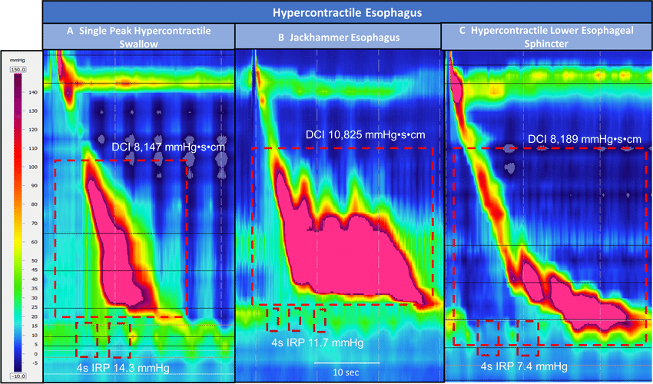

Slide 33
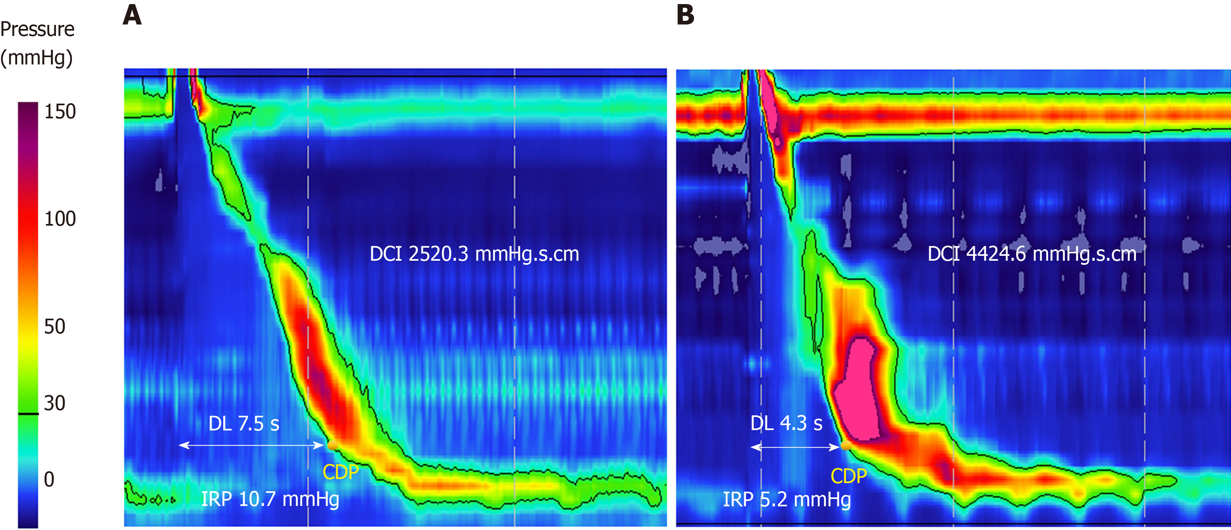
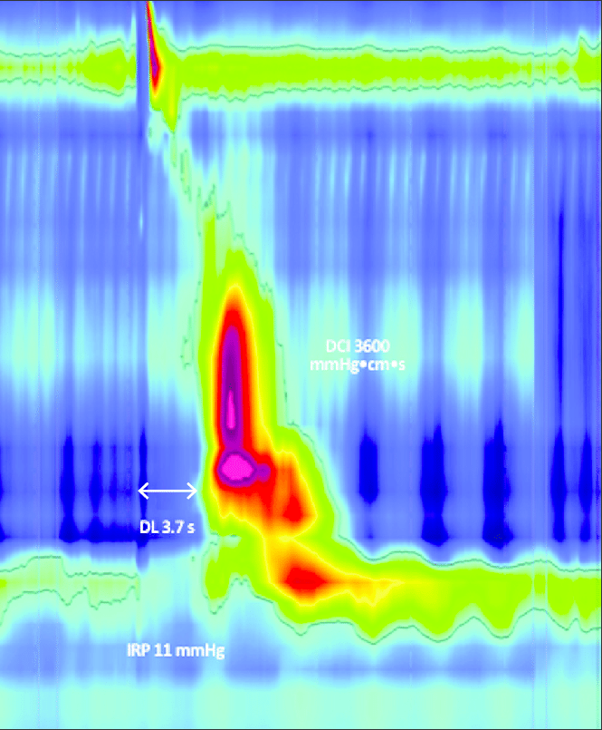
Distal esophageal spasms

Slide 34
Notes:
Treatment options in patients with disorders of esophageal peristalsis after a careful endoscopy is performed to rule out a mechanical or mucosal disease (such as eosinophilic esophagitis). *In patients with chest pain as the primary symptom, overlapping esophageal hypersensitivity might play a major role in symptom generation and neuromodulators or behavioral treatments might be beneficial based on studies on non-cardiac chest pain.
Patel et al. Page 26 Gastroenterology. Author

Slide 35
THANK YOU

